Slide 1
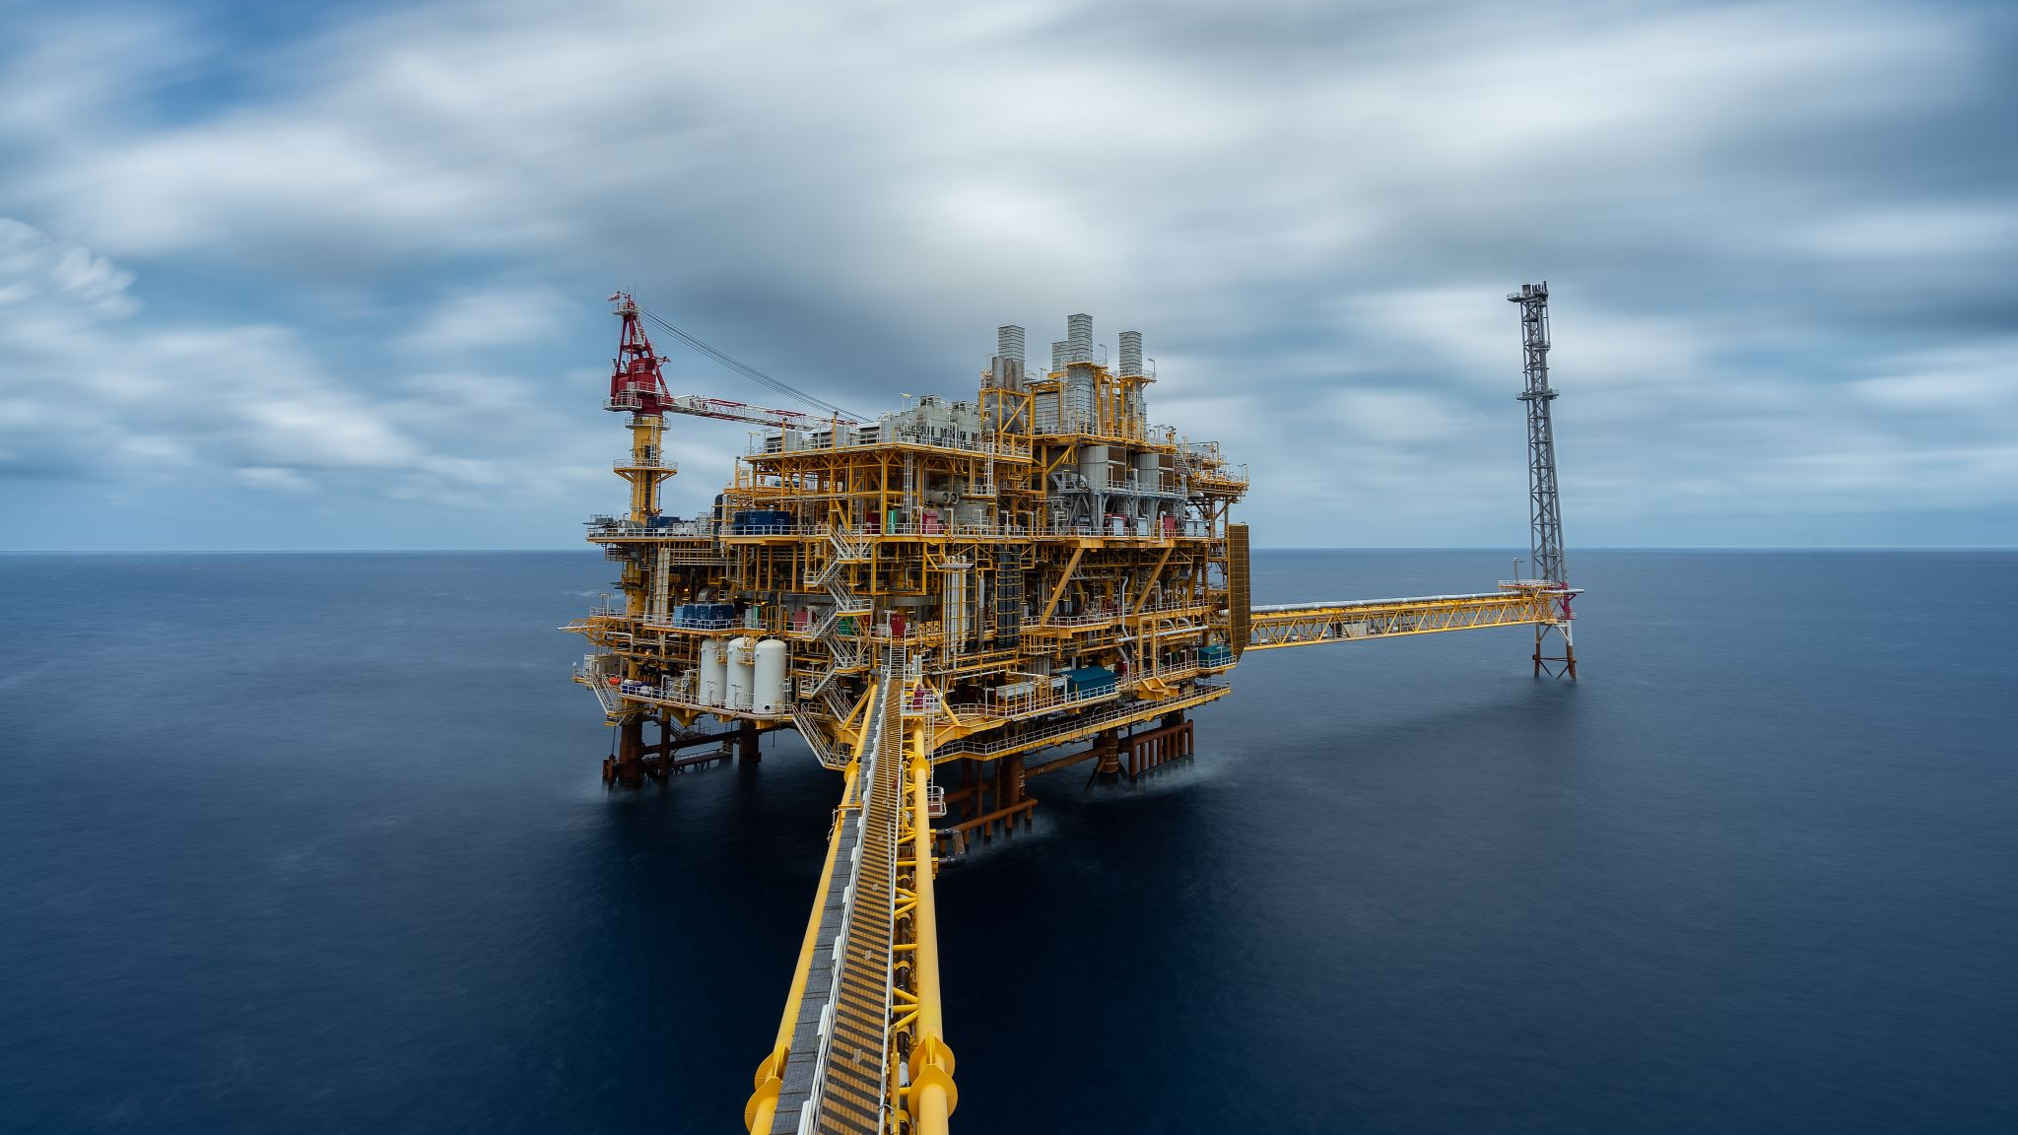
Pipeline Risk AI: Predicting Environmental Assessment on Kenya Oil Infrastructure

Slide 2





NEURONAUTS
Peter Mwaura
Entrepreneur/Innovator
Lisa Mwangi
Health Administrator/ Data Scientist
Kavetza Michelle
Petroleum Geologist/Data Scientist
David Masai
Health Systems Developer & Manager/
ML Engineer
Simon Ndichu
Statistician/ Data Analyst

Slide 3


Kenya and Africa more broadly are experiencing rapid growth in energy infrastructure, including new oil and gas pipelines. However, many of these projects intersect with sensitive ecological and social areas such as: -Human settlements -Roads and highways -Waterways and lakes Forest reserves and national parks Why It Matters: -Environmental degradation -Legal and financial liabilities -Disruption to communities and biodiversity -Infrastructure inefficiency and public opposition
BUSINESS UNDERSTANDING

Slide 4
Main Objective: To develop a predictive model that evaluates and optimizes oil and gas pipeline routes based on environmental risk and infrastructure cost, with a focus on Kenya and scalable use across Africa. Supporting Goals: Integrate geospatial layers (settlements, roads, rivers, lakes, national parks) Use machine learning to simulate and improve routing decisions Reduce future risks and delays through proactive planning Success Metrics: Minimized risk-weighted cost Improved environmental and community safety Alignment with existing infrastructure for cost efficiency
Cont…
Objective & Metrics

Slide 5
As Kenya expands its oil and gas infrastructure, the placement of pipelines may pose a significant environmental threat. Many of these projects are routed through or near ecologically sensitive areas such as forests, water bodies, and protected lands. Traditional impact assessments are slow, costly, and often reactive. This project aims to automate the environmental risk assessment process by evaluating a deep learning model that uses geospatial and pipeline metadata to classify infrastructure as high or low risk. Suitable or unsuitable and using spatial proximity to settlement.
PROBLEM STATEMENT

Slide 6
Which pipeline segments are in or near high-risk population areas? How does settlement and ecological features influence pipeline compliance? Which segments violate the minimum safe distance regulations?
Research QUESTIONS

Slide 7
Environmental Agencies: For fast, data-driven environmental review of proposed projects. Oil & Gas Developers: To identify and reduce environmental risks during pipeline planning. NGOs & Watchdogs: For advocacy and monitoring of high-risk developments. Policy Makers: To inform regulations and infrastructure zoning strategies.
TARGET AUDIENCE

Slide 8
DATA UNDERSTANDING
All features are spatially pinned using EPSG:4326.
Each layer is geometrically aligned with Turkana's boundary.
Risk is defined spatially by proximity to sensitive features (parks, lakes, settlement).
The new path improves observability, allowing better model training and evaluation.
The external datasets combined were :
Kenyan rivers and lakes shapefiles
Protected area boundaries (from WDPA)
Satellite-derived NDVI or landcover indices
Major roads and settlements

Slide 9
DATA SOURCES
Africa Energy Infrastructure Dataset (March 2025 Release) – oil & gas pipelines
WDPA (World Database on Protected Areas) – protected zones and parks
Natural Earth – rivers and lakes shapefiles
OpenStreetMap – geographic features and terrain overlays
NASA Earthdata – NDVI, landcover, and satellite imagery
Global Energy Monitor – supplemental pipeline and project metadata
Regional Centre For Mapping Of Resources For Development (RCMRD)

Slide 10
Using Python and GeoPandas it: Convert geometry linestring into pipeline lengths Calculate proximity to water bodies and protected areas Extract GPS point sequences from geometry for RL modeling Label pipelines as high/low environmental risk based on rules (e.g., length, proximity) Encode categorical attributes (route type) and normalize numerical ones
Data Preparation

Slide 11
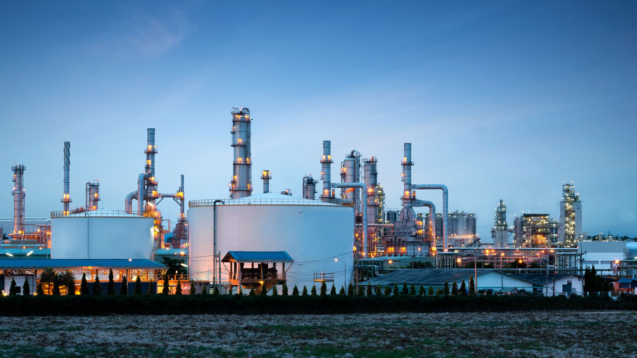
Raw Data sources
Coordinate Reference Systems
Geometric Processing
Feature Engineering
Rasterization

Slide 12
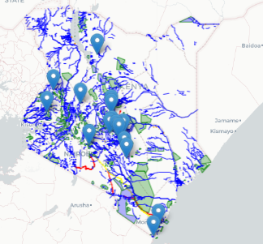
Atleast 2/3 of pipelines in Kenya are above groundhfdh
Geospatial mapping analysis
Geodata of all ecological zones ie waterways, forests, parks, conservancies, and the existing pipeline in Kenya.
This is an illustration of the route covered by the oil and gas pipeline in proximity to sensitive zones.

Slide 13
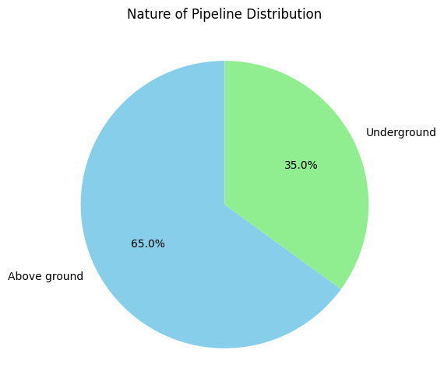
Atleast 2/3 of pipelines in Kenya are above ground
Exploratory DATA ANALYSIS

Slide 14
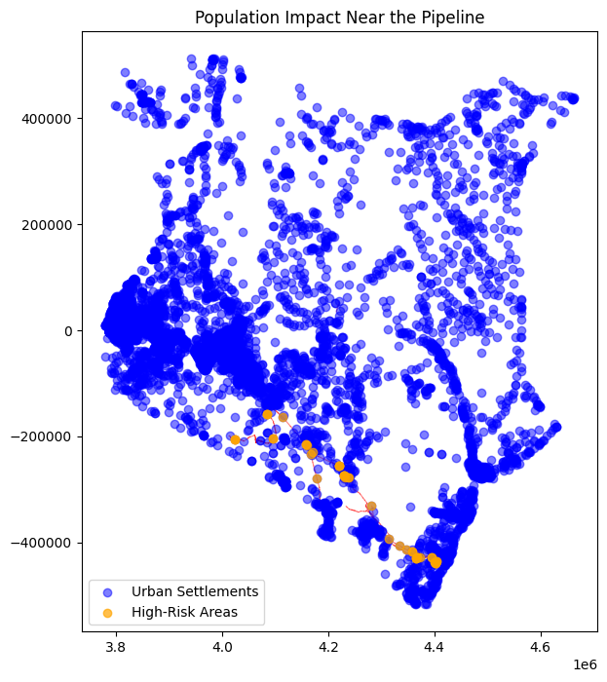
This graph shows the population highlighting the areas that are at high risk near/ along the pipelines.

Slide 15
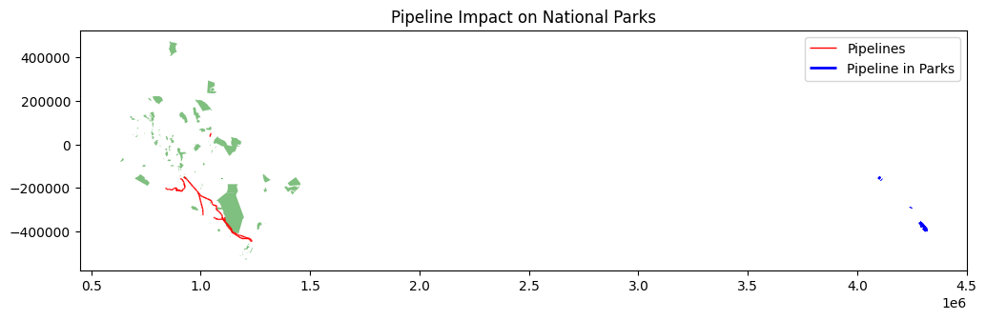
Exploratory DATA ANALYSIS

Slide 16
Exploratory DATA ANALYSIS
1. Tsavo East:- Percentage Coverage: 17.23%.
This indicates a moderate impact of pipelines on the park's boundary.
2. Ngai Ndethia:- Percentage Coverage: 1.43%.
The impact of pipelines on this park is minimal, as only a small fraction of its boundary is affected.
3. Nairobi National Park (Row 0):- Percentage Coverage: 30.43% of the park's boundary length is affected by pipelines.
This indicates a significant impact of pipelines on the park's boundary.

Slide 17

MODELING STRATEGY
Stacking (Stacked Generalization) is an ensemble technique that combines predictions from multiple base models to improve generalization
Goal: Capture different types of learning patterns and reduce individual model weaknesses.
Approach: A meta-model learns how to optimally combine base model outputs, often leading to higher predictive power than any single model alone.
Weighted F1-Score evaluates whether the meta-model effectively combines these predictions, especially for the minority High-risk class, which is critical for decision-making.

Slide 18
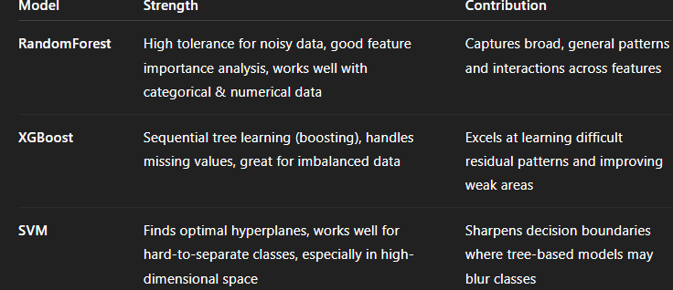
MODELS USED

Slide 19
RATIONALE:
RATIONALE:
By stacking RandomForest, XGBoost, and SVM, you:
Combine generalization, residual correction, and margin separation
Improve minority class detection (especially for high-impact decisions)
Increase robustness and reliability of predictions for real-world deployment

Slide 20
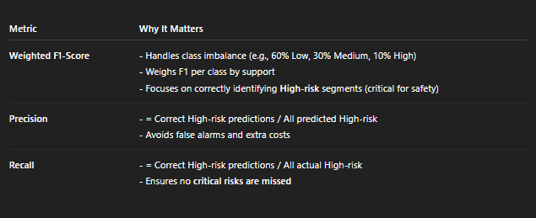
MODEL EVALUATION

Slide 21
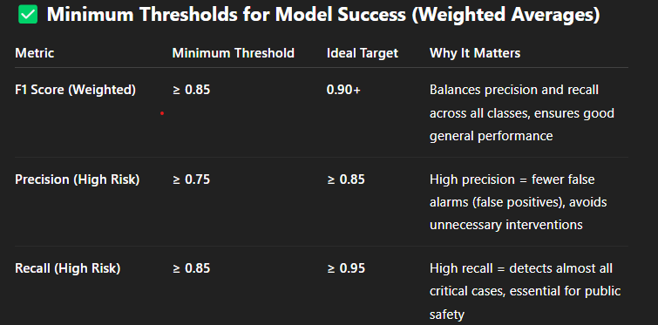
MODEL EVALUATION

Slide 22
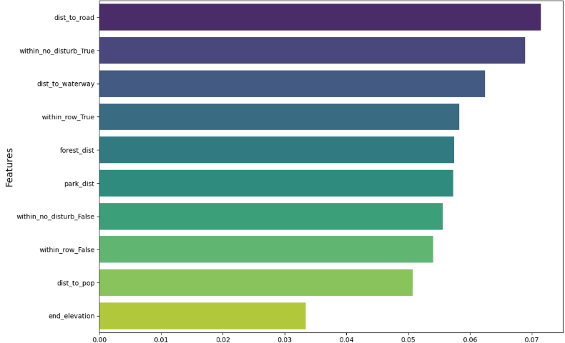
Feature Importance
Distance to road , within no disturbance of settlement show sensitivity to existing pipelines

Slide 23
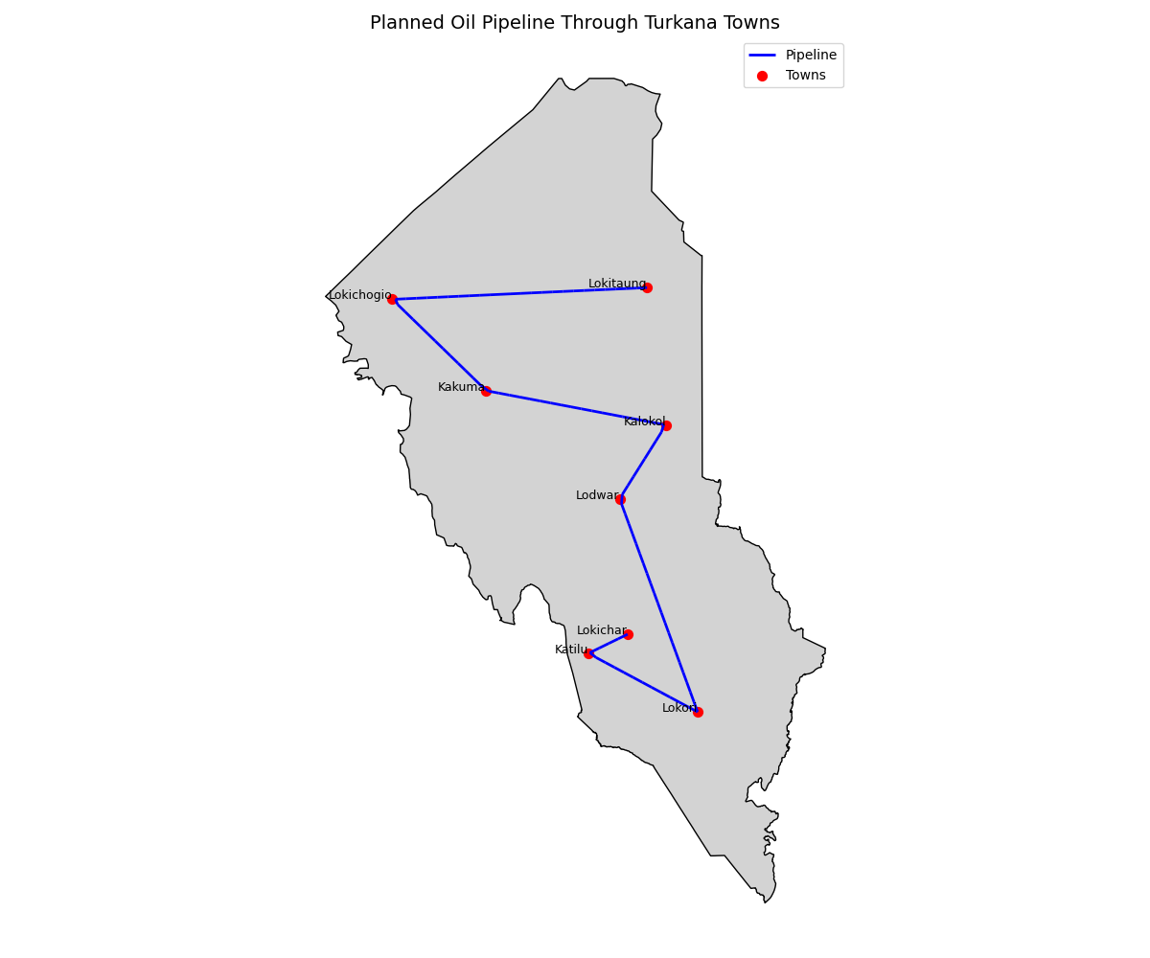
Map shows new test route pipeline in Turkana

Slide 24
DEPLOYMENT
The model will be deployed using Streamlit App, where users can:
Upload or select a pipeline
View pipeline on a map
See predicted environmental risk
It also include visual overlays of sensitive zones for context.

Slide 25
Recommendations
Ecological Sites
Focus on high-impact parks (e.g., Nairobi NP, Tsavo East)
Apply buffer zones to protect wildlife corridors
Collaborate with operators on eco-compliant routing
Curvature & Stress Points
Redesign segments with extreme angles or high curvature
Reinforce or realign high-risk pipeline curves
Expert Review
Prioritize high-risk intersections with roads and parks
Conduct targeted field evaluations and adjustments

Slide 26
Conclusion
Key Takeaways
Geospatial models support smarter, safer pipeline planning
Risk is highest near parks, settlements, and sharp curves
ML and spatial tools improve decision-making across Africa
Impact
Balances infrastructure growth with ecological protection
Enables proactive planning and mitigation

Slide 27
Any QUESTIONS?

Slide 28
THANK YOU

